Slide 1
Coastal Marine Health Recommendation System
Team Matrix:
Jay Bhorania
Kavish Jain
Maitry Shah
Ritvick Paliwal

Slide 2
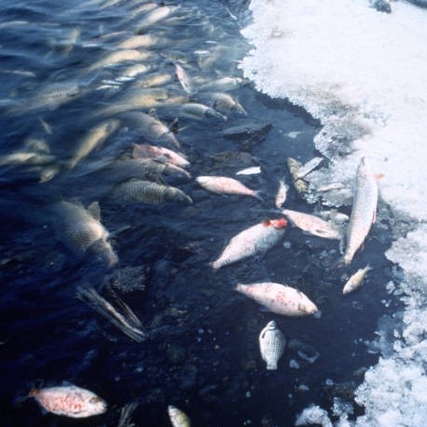
Pain Point
Marine life is getting affected due to impurities in the water
These impurities affect the pH of water, salinity, oxygen and carbon dioxide level
There is necessity to study the impact of these environmental factors on marine life health
Damage to Mother Earth

Slide 3
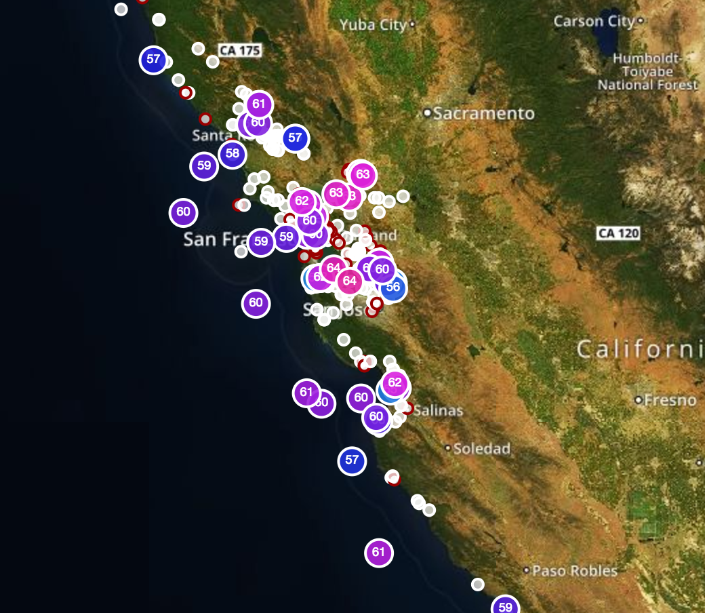
Data Source
Real time data from Cencoos The Central and Northern California Ocean observing System.
Sensors continuously record the data pertained to water salinity, acidity of ocean, oxygen and carbon dioxide level.

Slide 4
Project Statement
Analyzing Ocean Health Based on Real Time Cencoos data.
Building a recommendation system that helps to maintain marine life health.

Slide 5
Factors taken in consideration
pH level
Dissolved Oxygen
Carbon Dioxide level
Water Salinity
Temperature

Slide 6
Steps to achieve recommendation system
Data Reduction & Cleaning:
Removing null values and noise from the incoming data – Missing Value Ratio
Filtering the data and transforming it into usable format – Low Variance Filter
Data Transformation: Usable Formats
Clustering (Single Link Clustering):
Use single link clustering on data at a particular location from a specific period of time and on data at different locations at some particular time. -> Cluster based on Geo Location, -> Cluster based on Month-Year

Slide 7
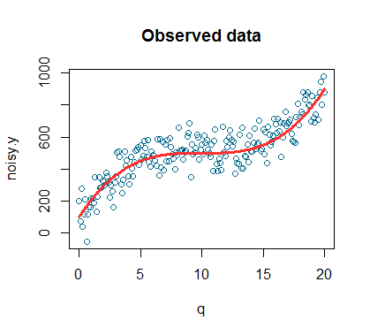
Regression
Regression analysis (Polynomial Regression):
Other Analysis we thought of - Linear

Slide 8

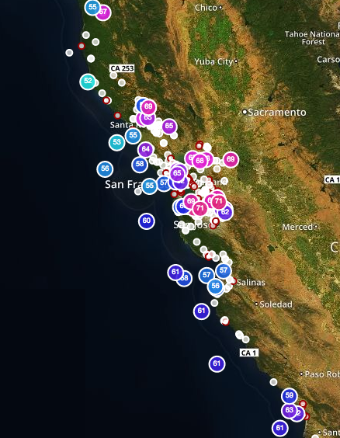
High level Architecture Design
Patterns, Evaluation and Visualization
Recommendation
Visualization
R
Real time Oceanic sensor Data is collected
IBM DashDB
Consume
Data Collection , Cleaning and Transformation (NodeJS)
Govt
BayKeeprs

Slide 9


Technologies
Analytics: IBM DashDB
Cloud Service: IBM Bluemix
Language – R Analytics, NodeJS
Processing Framework – Hadoop Map Reduce

Slide 10
THANK YOU

